Slide 1
Contact Manager
Small Project
Group 16

Slide 2
Members
-Jamison Rayfield (AWS and Apache configuration)
-Taharka Zubari (Use Case Diagram, Presentation)
- Jason Taylor (Frontend HTML and CSS)
-Justin Lambert ( Backend, API , Python / JavaScript support)
-Cole Silvernail ( MySQL design and script , ER Diagram)
-Gabriel Lara (Frontend API and design , JavaScript)

Slide 3
Project Description
Our team was tasked at creating a contact manager. The contact manager created is a web based application that allows users to create a contact list which is stored in a database.
The application provides the user with groundbreaking features such as…..
Adding contacts!
Searching contacts!
Deleting contacts!

Slide 4
Stack used
LAMP
-Linux: Operating System
-Apache: Web Server
-MySQL: Relational Database Management System (DBMS)
-Python: Backend API
- Amazon Web Server (AWS): Cloud Platform

Slide 5
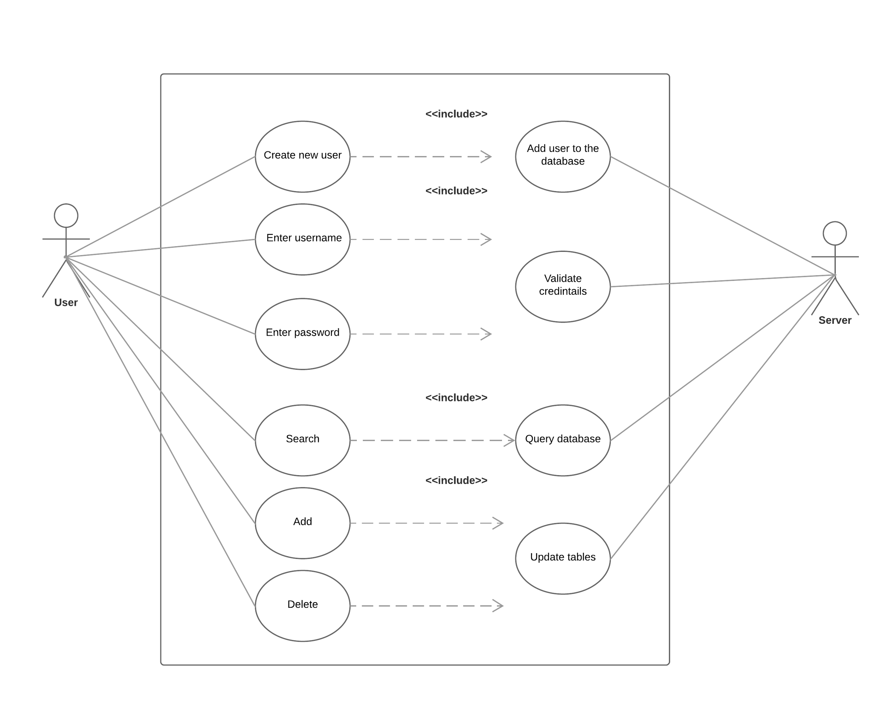
UML Use Case Diagram

Slide 6
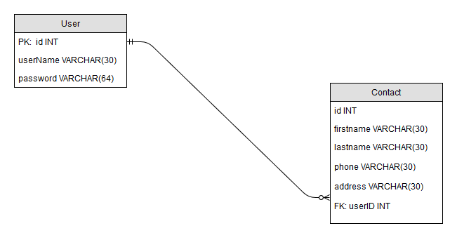
ER diagram

Slide 7
Difficulties
-Switched from WISA to LAMP stack (more online resources for LAMP)
- Learning new languages and frameworks
-Some Python libraries had sparse documentation
- Integrating Python with Apache
-Asynchronous communication between JavaScript and Python

Slide 8
Demo Time
URL: cop4331-group16.com

Slide 9

Questions

